Slide 1
Totally-ordered Multicast
Consider a bank with replicated data in San Francisco and New York City.
Customer in SF wants to add $100 to the account of $1000
Meanwhile, a bank employee in NY initiates an update by which the customer’s account will be increased with 1% interest.
Due to communication delays, the instructions could arrive at the replicated sites in different orders with differing final answers
Should have been performed at both sites in same order

Slide 2
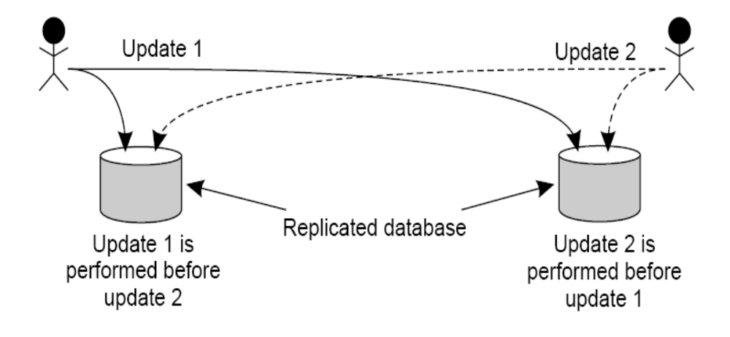
An Application of
Totally-Ordered Multicast
Updating a replicated database and leaving it in an inconsistent state.
GMU – CS 571

Slide 3
Totally-Ordered Multicast (Cont.)
Each multicast message is always time-stamped with the current (logical) time of its sender.
When a (kernel) process receives a multicast update request:
  It first puts the message into a local queue instead of directly delivering to the application (i.e. instead of blindly updating the local database). The local queue is ordered according to the timestamps of update-request messages.
  It also multicasts an acknowledgement to all other processes (naturally, with a timestamp of higher value).
GMU – CS 571

Slide 4
An Application:
Totally-Ordered Multicast (Cont.)
Local Database Update Rule
A process can deliver a queued message to the application it is running (i.e. the local database can be updated) only when that message is at the head of the local queue and has been acknowledged by all other processes.
GMU – CS 571

Slide 5
An Application:
Totally-Ordered Multicast (Cont.)
For example: process 1 and process 2 each want to perform an update.
Process 1 sends update requests with timestamp t_{x} to itself and process 2
Process 2 sends update requests with timestamp t_{y} to itself and process 1
When each process receives the requests, it puts the requests on their queues in timestamp order. If t_{x} = t_{y} then process 1’s request is first. NOTE: the queues will be identical.
Each sends out acks to the other (with larger timestamp).
The same request will be on the front of each queue – once the ack for the process on the front of the queue is received, its update is processed and removed.
GMU – CS 571

